Slide 1
Complex FM
Involves multiple carriers and/or modulators
Parallel carriers useful for simulating “formants” – see Morrill Trumpet and Chowning Soprano instruments in Dodge
Stacked or parallel modulators useful for generating very rich spectra with relatively small indices of modulation

Slide 2
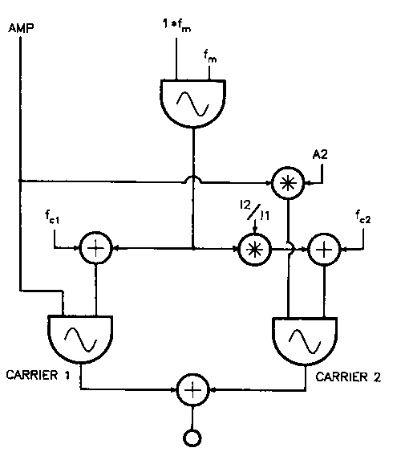
Dodge FM Formant Instrument

Slide 3
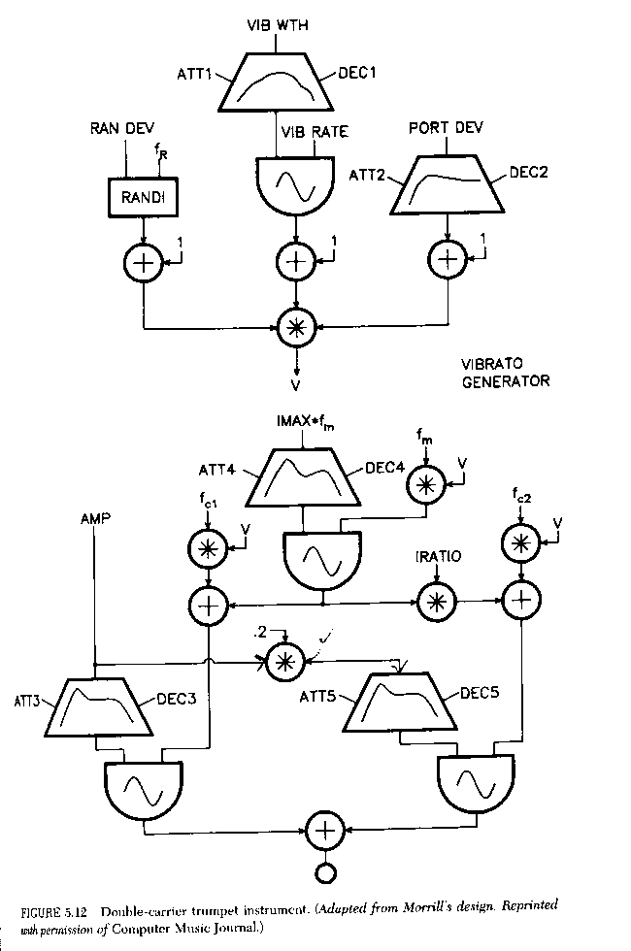
Morrill FM Trumpet

Slide 4
Morrill Vibrato Design

Slide 5
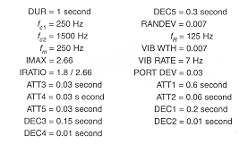
Dodge/Morrill Parameters

Slide 6
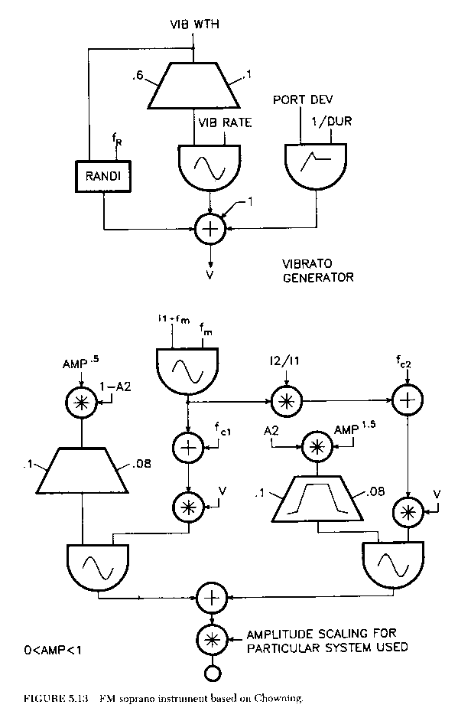
Chowning FM Soprano

Slide 7
Chowning Soprano Vibrato

Slide 8
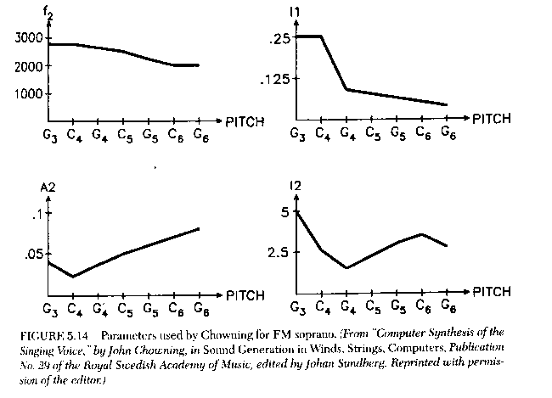
Soprano Parameter Mapping

Slide 9
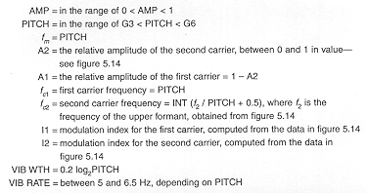
Dodge/Chowning Parameters

Slide 10
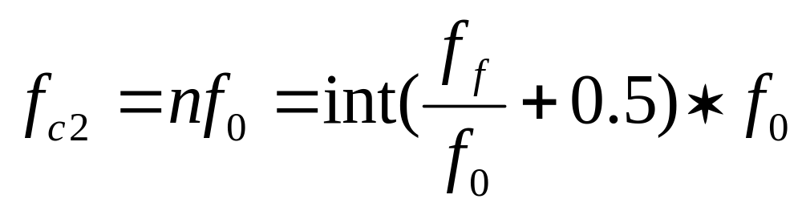
Notes on Dodge FM Examples
Dodge FM Formant Formula:
Error P. 131:
fc2 = INT(f2/PITCH+.5) * PITCH

Slide 11
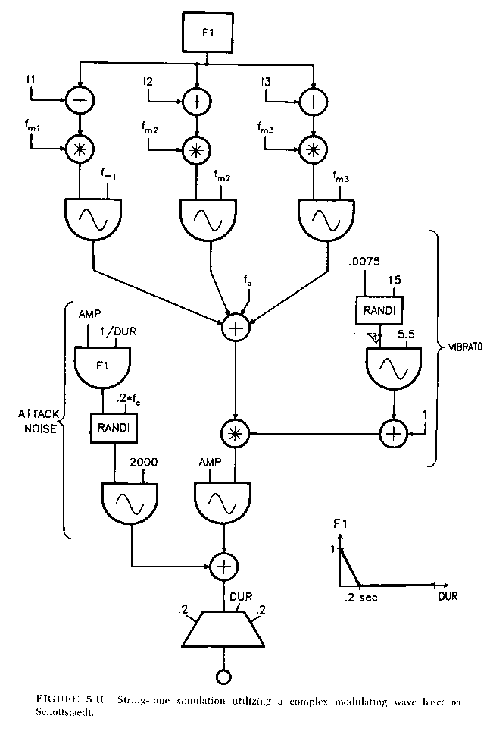
Schottstaedt FM Strings

Slide 12
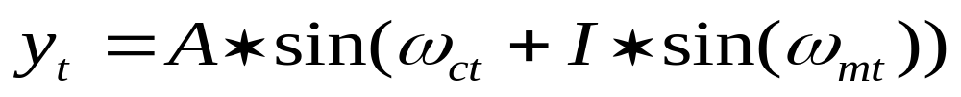
Phase Modulation
Phase Modulation (PM)
  Closely related to FM, but instantaneous phase of the carrier is modulated, not the frequency
  Spectrum virtually identical to FM, but avoids certain artifacts (e.g., carrier drift) and allows “feedback” (carrier modulates itself)
  Formula is actually Chowning’s original:

Slide 13
Phase Modulation in Csound
For any carrier, use a phasor + table
Index is a value in radians, so divide by 2pi to convert to a normalized index to table
amod oscili index/2pi,imodhz,isinefn
acarphs phasor icarhz
acarsig tablei acarphs+amod,isinefn,1,0,1
afinal = acarsig * ampfac

Slide 14
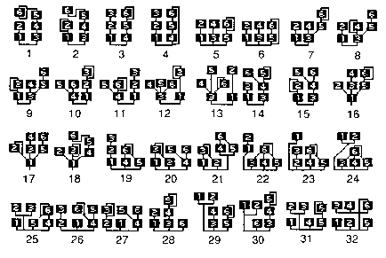
Yamaha DX 7 Algorithms

